Slide 1
DELHI PUBLIC SCHOOL JORHAT
Kaizen Meeting template for Class IX to XII

Slide 2
TOPICS
01
SYLLABUS COMPLETION
04
TOURS & FIELD VISITS DONE
02
LESSON PLANNING
05
ASSESSMENTS TAKEN & EXAM PERFORMANCE
03
BEST PRACTICES IN YOUR SUBJECTS
06
COPY CORRECTION & MAINTENENCE

Slide 3
TOPICS
07
BEHAVIOURAL OBSERVATION OF STUDENTS
08
CO SCHOLASTIC ACTIVITIES DONE IN YOUR SUBJECT
09
MEASURES TAKEN WHEN STUDENTS MISS CLASSES AND COMMUNICATION/INSTRUCTIONS PROVIDED TO PARENTS

Slide 4
DELHI PUBLIC SCHOOL JORHAT
Kaizen Presentation
Subject: English
Teacher: Sushmita Ghosh
Classes: IX & XI

Slide 5
SYLLABUS COMPLETION
01

Slide 6
SYLLABUS COMPLETION
The following lessons and writing skills were planned to be covered during April–June 2026:
Class IX | Class XI
The Fun They Had The Lost Child The Sound of Music The Road Not Taken Letter to the Editor Notice Writing The Adventure of Toto. | The Portrait of a Lady A Photograph We’re Not Afraid to Die... If We Can All Be Together Notice Writing Posters
The above-mentioned syllabus has been successfully covered as per the planned curriculum schedule during the reporting period (April–June 2026).

Slide 7
LESSON PLANNING
02

Slide 8
LESSON PLANNING
Lesson planning is carried out in a structured and student-centred manner, ensuring meaningful learning experiences.
Equal emphasis is given to literature, language skills, critical thinking, and creative expression.
For Class IX, lessons are planned to strengthen reading comprehension, interpretation, communication, and writing skills through prose, poetry, and functional writing.
For Class XI, lesson planning focuses on literary appreciation, analytical thinking, effective communication, and creative writing through prose, poetry, and varied writing tasks.

Slide 9
Learning experiences are designed to encourage active participation, collaboration, and independent thinking.
Teaching strategies include interactive discussions, inquiry-based learning, text analysis, creative writing activities, real-life connections, and technology-integrated classroom practices.
Continuous feedback and skill-based assessment are incorporated to support learner growth and achievement.
Grade IX Drive Link: https://drive.google.com/drive/folders/1uTUhizj9z-2f8dNG4rloU9IgmzMp6HCw
Grade XI Drive Link: https://drive.google.com/drive/folders/1dOyWwxga6-CqC-0lHyCFx9OX3tG2V5dZ

Slide 10
BEST PRACTICES IN YOUR SUBJECT
03

Slide 11
BEST PRACTICES
• Integration of literature with language learning
• Use of real-life examples and contextual learning
• Question-answer method to promote engagement and understanding
• Classroom discussion and interpretation of texts
• Focus on reading comprehension and writing skills
• Encouragement of student participation and expression
• Continuous feedback for academic improvement

Slide 12
ASSESSMENTS TAKEN & EXAM PERFORMANCE
04

Slide 13
ASSESSMENTS TAKEN
Regular assessments are conducted to monitor students’ progress, strengthen language skills, and ensure continuous learning.
Class IX | Class XI
Cycle Test conducted as per school schedule. Regular evaluation through classwork, homework, and classroom activities. Practice and assessment of notice writing, letter writing, textual questions, and literature-based responses. Continuous feedback provided to improve writing and comprehension skills. | Regular assessment through written tasks and classroom exercises. Practice and evaluation of notice writing, poster writing, comprehension, and interpretation-based questions. Assessment of prose and poetry responses to enhance analytical and writing abilities. Continuous monitoring of student performance with timely feedback and support.

Slide 14
Class | Assessment Type | Date
IX-A | Monday Test | 20.04.2026
IX-B | Monday Test | 20.04.2026
XI-COM | Yet to be Conducted | Scheduled on 03.08.2026

Slide 15
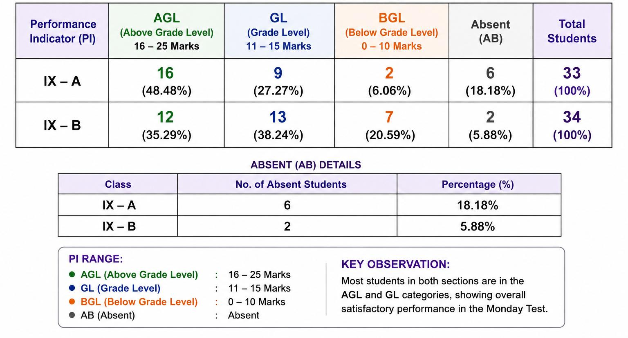
EXAM PERFORMANCE

Slide 16
COPY CORRECTION & MAINTENANCE
05

Slide 17
COPY CORRECTION AND MAINTENANCE
Copy correction is conducted regularly to monitor students’ written work and provide constructive feedback. Emphasis is placed on accuracy, presentation, handwriting, and completion of work.
Focus Areas:
Focus Area | Action Taken
Accuracy of Written Work | Reviewed and corrected
Grammar & Spelling Errors | Identified and corrected
Handwriting | Individual feedback provided
Presentation of Work | Emphasis on neatness and organization
Completion of Work | Monitored regularly

Slide 18
CLASS –WISE STATUS OF COPY CORRECTION
Class | Status
IX- A | Completed and Verified
IX-B | Completed and Verified
XI- COMMERCE | Completed and Verified

Slide 19
BEHAVIOURAL OBSERVATION OF STUDENTS
06

Slide 20
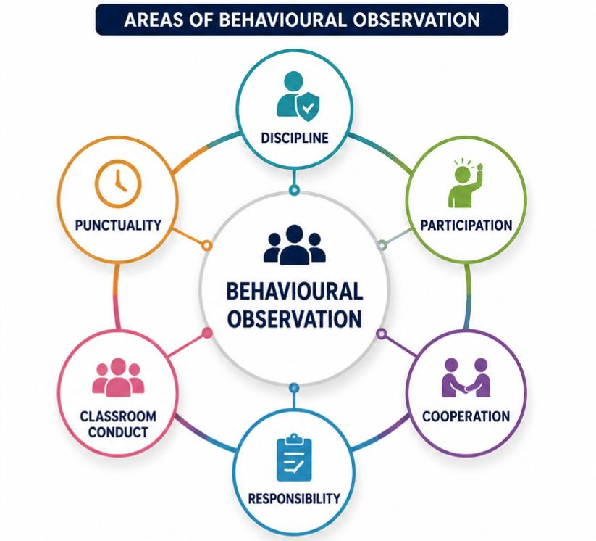
BEHAVIOURAL OBSERVATION OF STUDENTS
Behavioural observation records are maintained digitally and organized class-wise for systematic monitoring, review, and follow-up.
Class | Digital Record
IX-A | Drive Link
IX- B | Drive Link
XI COMMERCE | Drive Link

Slide 21

MEASURES TAKEN WHEN STUDENTS MISS CLASSES

Slide 22
THANK YOU
Questions and Feedback are Welcome

