Slide 1
DELHI PUBLIC SCHOOL JORHAT
Class XI &XII

Slide 2
TOPICS
01
SYLLABUS COMPLETION
04
TOURS & FIELD VISITS DONE
02
LESSON PLANNING
05
ASSESSMENTS TAKEN & EXAM PERFORMANCE
03
BEST PRACTICES IN YOUR SUBJECTS
06
COPY CORRECTION & MAINTENENCE

Slide 3
TOPICS
07
BEHAVIOURAL OBSERVATION OF STUDENTS
08
CO SCHOLASTIC ACTIVITIES DONE IN YOUR SUBJECT
09
MEASURES TAKEN WHEN STUDENTS MISS CLASSES AND COMMUNICATION/INSTRUCTIONS PROVIDED TO PARENTS

Slide 4
KINDLY START YOUR PRESENTATION FROM NEXT SLIDE

Slide 5
SYLLABUS COMPLETION
01

Slide 6
TOPIC: SYLLABUS COMPLETION
GRADE XI: SOCIOLOGY
CHAPTER 1: SOCIOLOGY, SOCIETY and its RELATIONS with OTHER SOCIAL SCIENCE
CHAPTER 2: TERMS, CONCEPTS and their USES in SOCIOLOGY

Slide 7
TOPIC: SYLLABUS COMPLETION
GRADE XII: SOCIOLOGY
CHAPTER 1: INTRODUCING INDIAN SOCIETY (non-assessment)
CHAPTER 2: THE DEMOGRAPHIC STRUCTURE OF INDIAN SOCIETY
CHAPTER 3: SOCIAL INSTITUTIONS: CONTINUITY and CHANGE

Slide 8
TOPIC: SYLLABUS COMPLETION
GRADE XII: SOCIOLOGY
CHAPTER 4: PATTERN OF SOCIAL IMEQUALITY and EXCLUSION

Slide 9
LESSON PLANNING
02

Slide 10
TOPIC: LESSON PLANNING
GRADE XII : SOCIOLOGY
DRIVE LINK -
GRADE XI SOCIOLOGY
DRIVE LINK -

Slide 11
03
BEST PRACTICES IN HISTORY

Slide 12
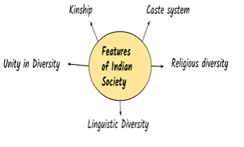
FEATURES OF INDIAN SOCIETY
-

Slide 13
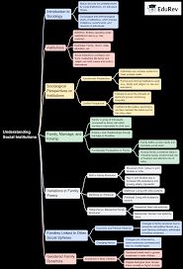
BEST PRACTICES IN SOCIOLOGY
USE OF MIND MAP FOR EVERY CHAPTER
GRADE XII

Slide 14
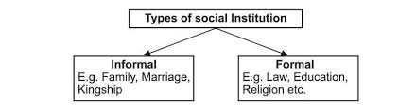
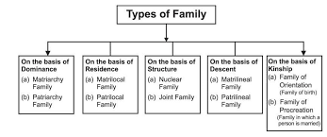
BEST PRACTICES IN SOCIOLOGY
GRADE XII

Slide 15

BEST PRACTICES
GRADE XII - SOCIOLOGY

Slide 16
04
TOURS & FIELD VISITS DONE

Slide 17
TOURS & FIELD VISITS DONE
Class | Destination | Date
XII |  | Last week of July 2026
XI |  | Last week of July 2026

Slide 18
05
ASSESSMENTS TAKEN & EXAM PERFORMANCE

Slide 19
ASSESSMENTS TAKEN & EXAM PERFORMANCE
Assessment was done on different basis: like--
CLASS TEST
CYCLE TEST
CLASS DISCUSSION

Slide 20
ASSESSMENTS TAKEN & EXAM PERFORMANCE
Class | Assessment Type | Date | Avg. Score | Key Observations
XI | CLASS TEST 1 | 3 JUNE | 63.4%
XI | UNIT TEST | 11 JUNE
XII | CYCLE TEST | 18 MAY | 58%
XII | CLASS TEST | 22 MAY | 62%
XII | CLASS TEST | 9 JUNE | 60%

Slide 21
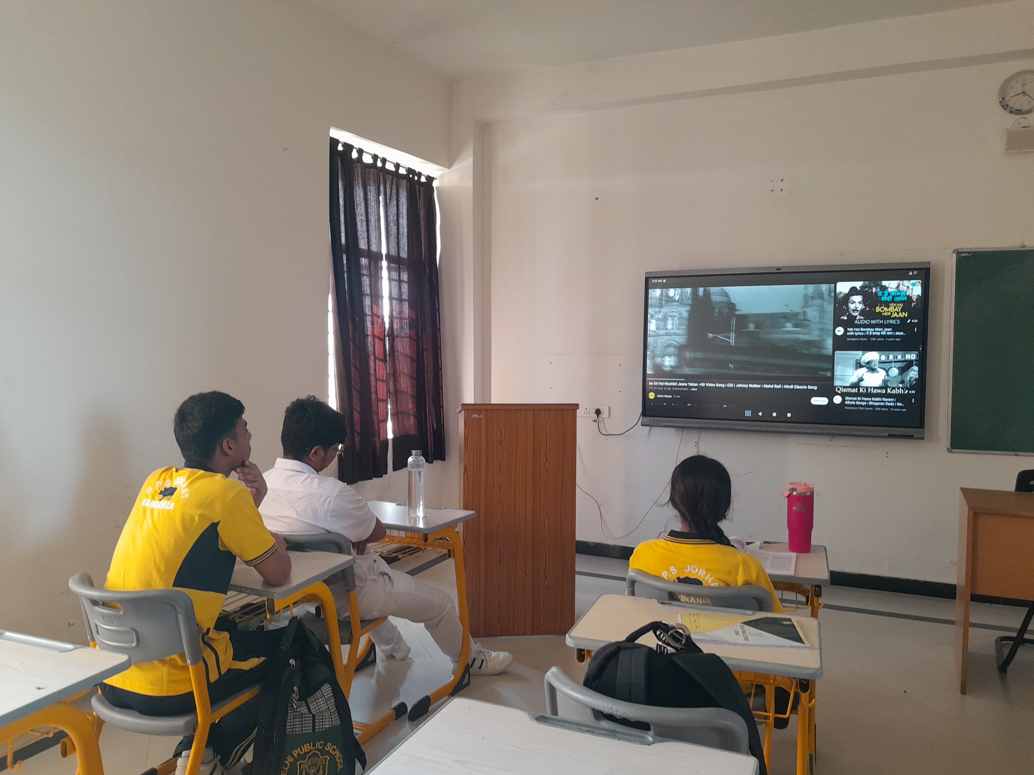
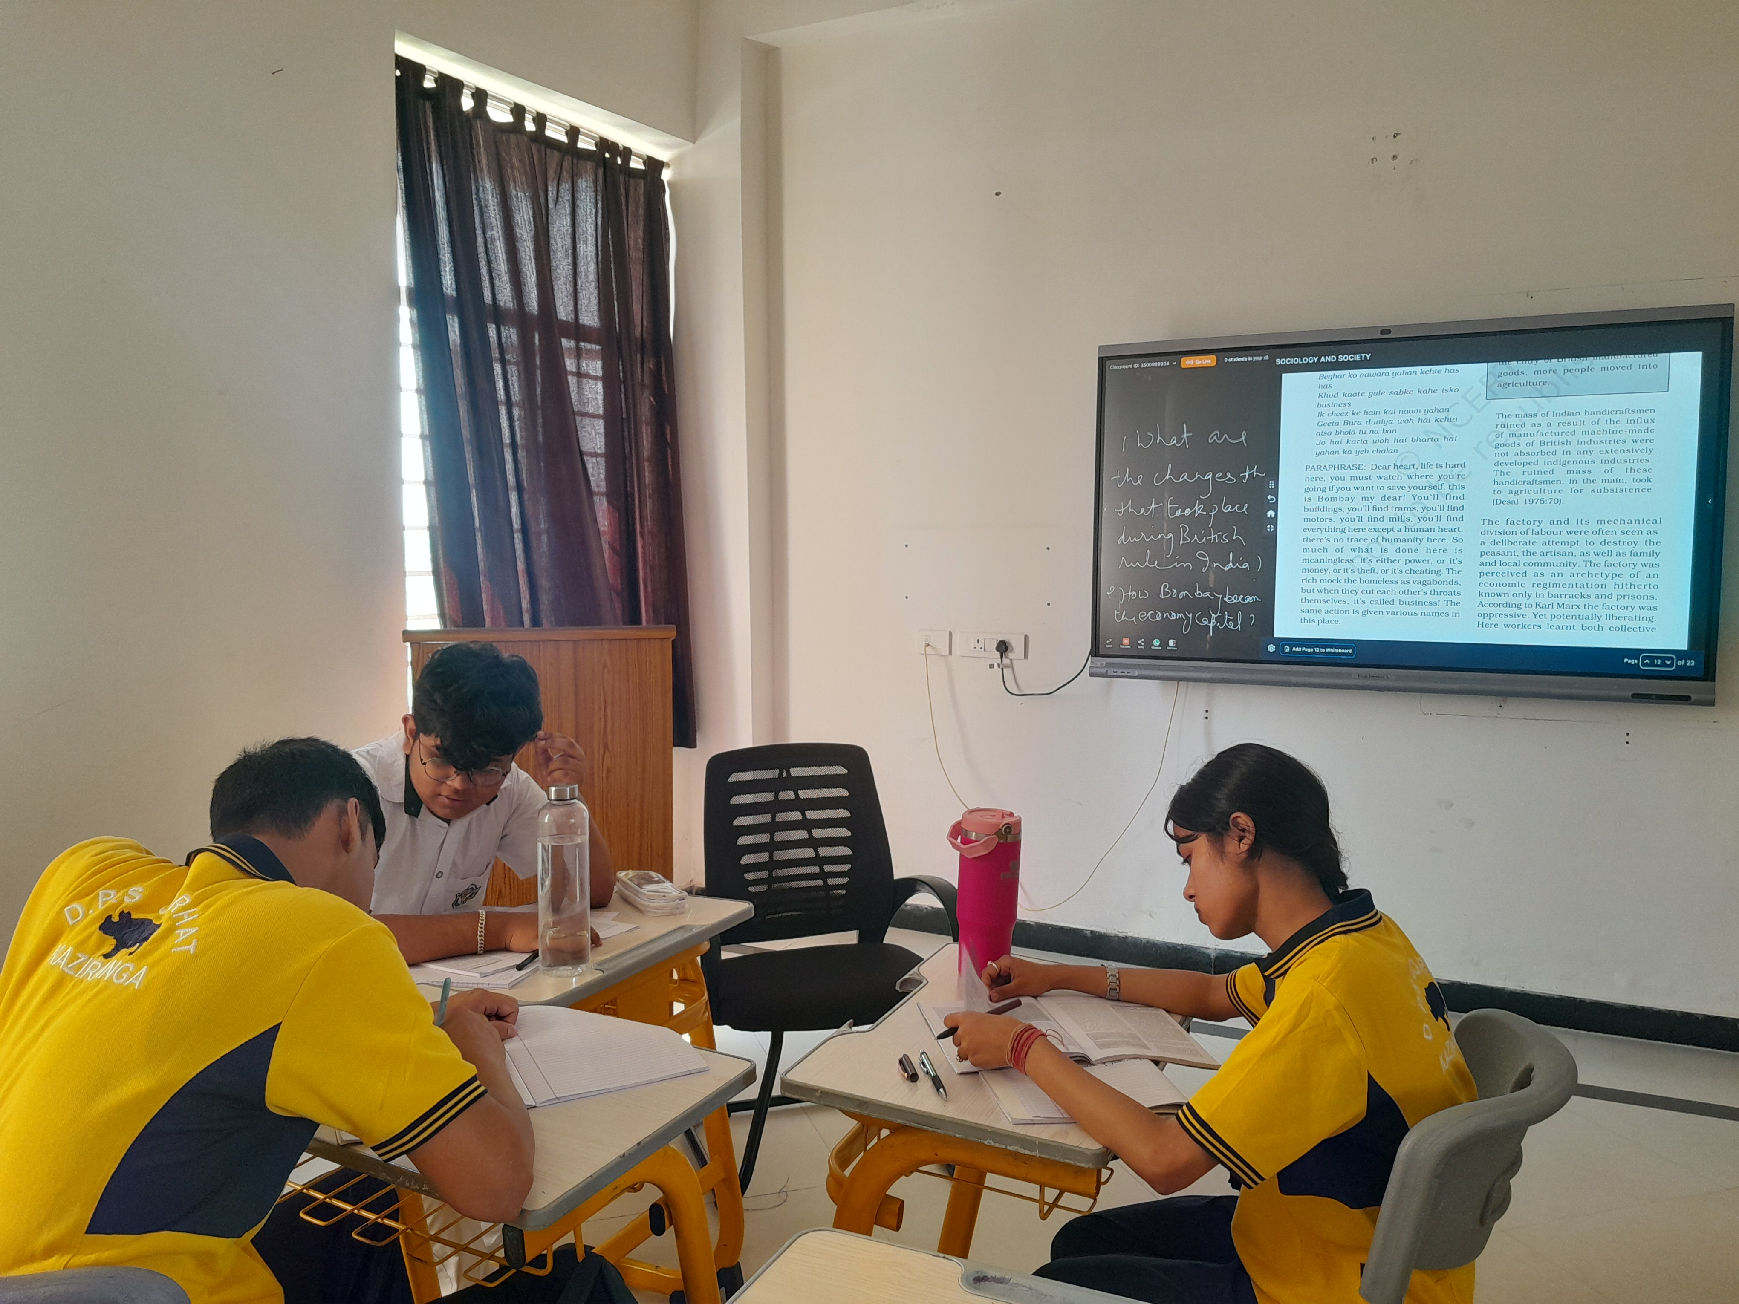
PICTURES

Slide 22
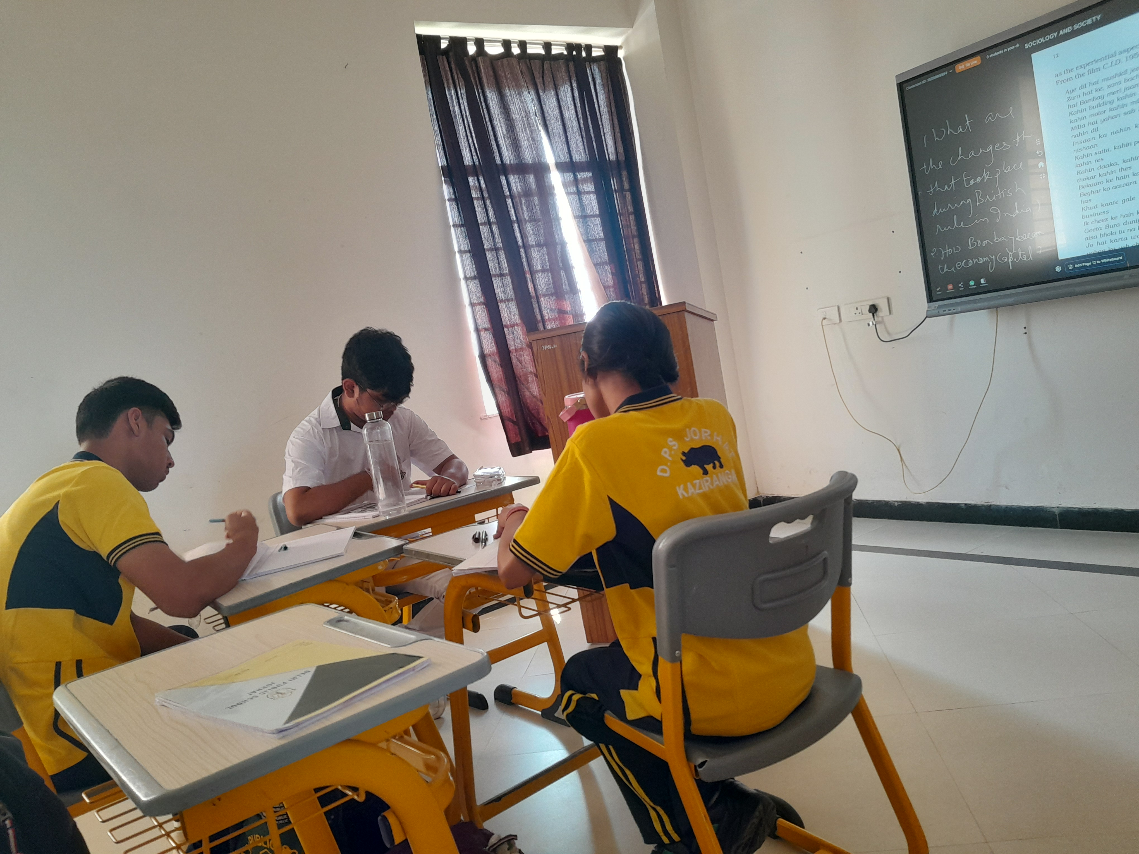
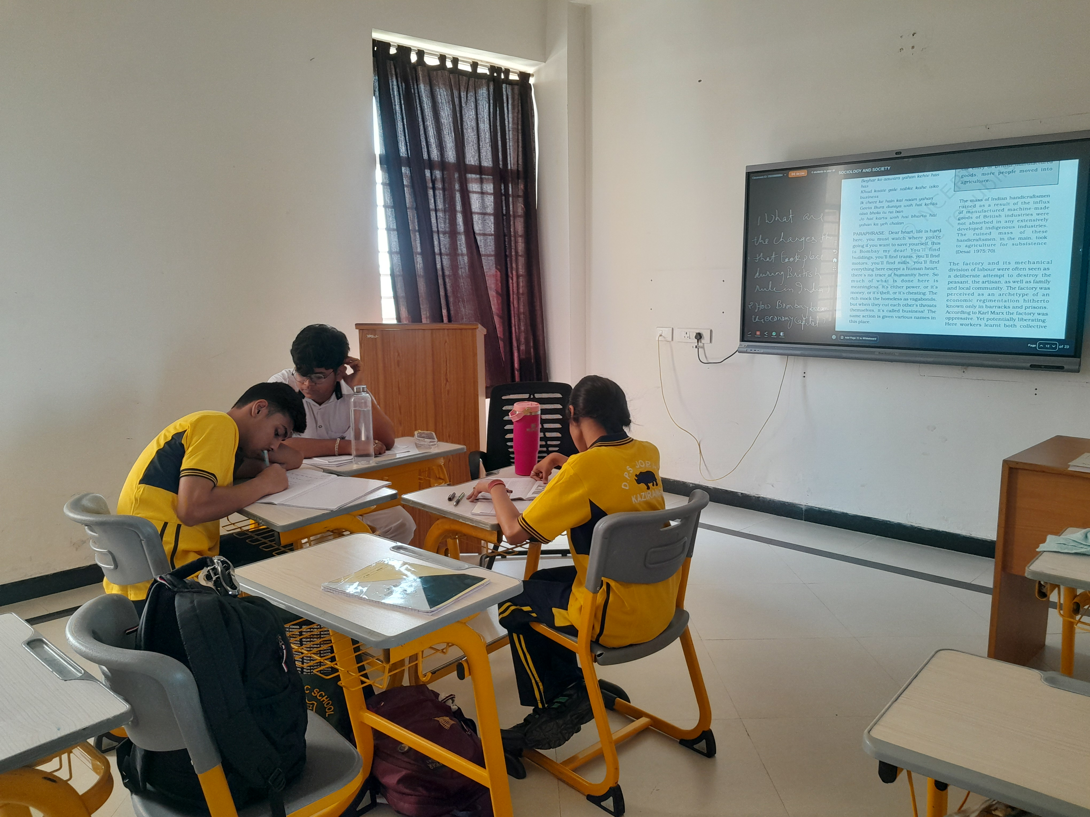

Slide 23
06
ASSESSMENTS TAKEN & EXAM PERFORMANCE

Slide 24
THANKS!
Please keep this slide for attribution

