Slide 1
DELHI PUBLIC SCHOOL JORHAT
KAIZEN PRESENTATION 2026-2027
SUBJECT : BIOLOGY
CLASS IX

Slide 2
TOPICS
01
SYLLABUS COMPLETION
04
TOURS & FIELD VISITS DONE
02
LESSON PLANNING
05
ASSESSMENTS TAKEN & EXAM PERFORMANCE
03
BEST PRACTICES IN YOUR SUBJECTS
06
COPY CORRECTION & MAINTENENCE

Slide 3
TOPICS
07
BEHAVIOURAL OBSERVATION OF STUDENTS
08
CO SCHOLASTIC ACTIVITIES DONE IN YOUR SUBJECT
09
MEASURES TAKEN WHEN STUDENTS MISS CLASSES AND COMMUNICATION/INSTRUCTIONS PROVIDED TO PARENTS

Slide 4
SYLLABUS COMPLETION
01

Slide 5
SYLLABUS COMPLETION
CHAPTER 2 : Cell: The Building block of life
SUB TOPICS :
Cell discovery and history
How to study cell ?
Structure of a cell
Cell membrane and Cell wall
The cell interior

Slide 6
SYLLABUS COMPLETION
Why do eukaryotic cells need organelles ?
Types of cell organelles
How do normal cells grow and divide ?
Cell Theory

Slide 7
CHAPTER OUTLINE

Slide 8
LESSON PLANNING
0 2

Slide 9
LESSON PLANNING
APPROACHES USED
Learner - Centred Approach
Activity- Based Approach
Competancy - Based Questions
STRATEGIES. USED
Discussion
Demonstration
Question Answer Method
Lecture- cum- discussion
Hands on learning

Slide 10
BEST PRACTICES IN BIOLOGY
0 3

Slide 11
BEST PRACTICES IN BIOLOGY
Use of concept / Mind maps
Use of colourful presentation
Hands -on - learning in labs.
Use of AI in teaching biology.
Making topics more clear through practical application.

Slide 12
HANDS ON LEARNING
LAB Activity :To prepare a stained, temporary mount of onion peel and to study its cells.
Curriculum Goals
To understand the basic structure of a plant cell.
To develop skills in preparing temporary microscopic slides.
To learn the proper use and handling of a microscope.
To observe and identify different cell organelles visible in plant cells.

Slide 13
HANDS ON LEARNING
LAB Activity :To prepare a stained, temporary mount of onion peel and to study its cells.
LEARNING OUTCOMES:
Students will be able to:
Prepare a temporary mount of an onion peel correctly.
Use of a compound microscope effectively to observe cells
Identify major parts of plant cell.
Draw a labelled and a neat diagram of onion peel cell.
Record observation and developed scientific attitudes by the students.

Slide 14
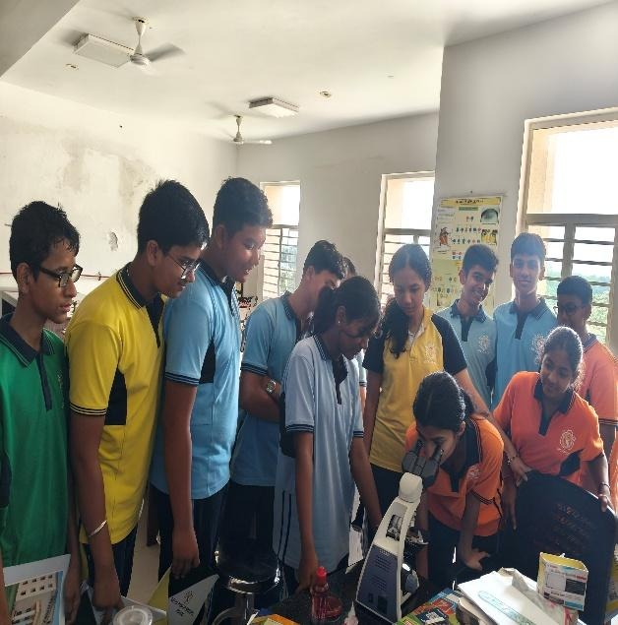
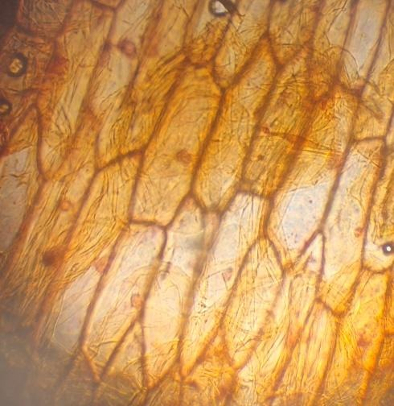
HANDS ON LEARNING
STUDENTS OBSERVING UNDER MICROSCOPE
ONION PEEL UNDER 45X COMPOND MICROSCOPE

Slide 15
ASSESSMENT TAKEN
0 4

Slide 16
ASSESSMENT TAKEN
Class Test
Practice Extra Questions
Laboratory practical

Slide 17
ASSESSMENTS
CLASS IX
Cycle Test to be conducted [27/7/2026]

Slide 18
COPY CORRECTION AND MAINTENANCE
0 5

Slide 19
COPY CORRECTION AND MAINTENANCE
Class IX Notebooks checked
Regular record keeping in the subject register.

Slide 20
MEASURES TAKEN WHEN STUDENTS MISS CLASSES AND INSTRUCTIONS PROVIDED TO PARENTS
0 6

Slide 21
MEASURES TAKEN WHEN STUDENTS MISS CLASSES AND INSTRUCTION PROVIDED TO PARENTS
Study Materials as PPT shared with the students.
Class room notes shared
In free Periods absentees individual guidance given.
Attending/ clearing personal queries of students and parents [if any]
Proper brush up of the chapters before Class Test.

Slide 22
SUBJECT RELATED PROBLEMS AND SOLUTIONS
SL. NO. | SUBJECT RELATED PROBLEMS | SOLUTIONS
1. | DIAGRAMS | EASY SCHEMATIC REPRESENTATION
2. | CHAPTER BASICS | MIND MAP
3. | DIFFICULT CONCEPTS | FLOW CHARTS

Slide 23
FOLLOW UP
SUMMER PROJECTS
DEVELOPING INNOVATIVE IDEAS
MODEL IDEAS FOR SCIENCE EXHIBITION
MORE INVOLVEMENT IN LAB ACTIVITIES
PRESENTATIONS

Slide 24
THANK YOU

