Slide 1
DELHI PUBLIC SCHOOL JORHAT
Kaizen Meeting template for Class IX to XII

Slide 2
TOPICS
01
SYLLABUS COMPLETION
02
LESSON PLANNING
03
BEST PRACTICE

Slide 3
TOPICS
04
TOURS AND FIELD VISITS
05
ASSESSMENT TAKEN &EXAM PERFORMANCE
03
COPY CORRECTION &MAINTENCE

Slide 4
TOPICS
07
BEHAVIOURIAL OBSERVATION OF STUDENTS
08
MEASURES TAKEN WHEN STUDENTS MISS CLASSES
09
COMMUNICATION /INSTRUCTION PROVIDED

Slide 5
SYLLABUS COMPLETION (IX)
01

Slide 6
SYLLABUS COMPLETION
GRADE IX (A& B)
CHAPTER 1: India :Size and location
CHAPTER 2: Physical features of India

Slide 7
LESSON PLAN
02

Slide 8
LESSON PLAN
GRADE IX (A&B)
CHAPTER 1: India :Size and location
DRIVE LINK: https://docs.google.com/document/d/185vd1-ENBywA8aQjshHn0D2lmHc-18vl/edit?usp=drive_link&ouid=115569262971133522053&rtpof=true&sd=true
CHAPTER 2: Physical features of India
DRIVE LINK:

Slide 9
SYLLABUS COMPLETION
GRADE X (A& B)
CHAPTER 1: RESOURCES AND DEVELOPMENT
CHAPTER 2: FOREST AND WILD LIFE RESOURCES
CHAPTER 3:WATER RESOURCES

Slide 10
LESSON PLAN
X (A&B)
CHAPTER 1: RESOURCES AND DEVELOPMENT
LINK:https://docs.google.com/document/d/1pW5ZYuHpytJSailEPG1NIvjDKfPNqfK7/edit?usp=drive_link&ouid=115569262971133522053&rtpof=true&sd=true
CHAPTER 2: FOREST AND WILD LIFE RESOURCES LINK:https://drive.google.com/drive/folders/1jsNzPteVjMec_Q8YDHkX2ehyCawOejql?usp=drive_link
CHAPTER 3:WATER RESOURCES
DRIVE LINK:https://drive.google.com/drive/folders/1jsNzPteVjMec_Q8YDHkX2ehyCawOejql?usp=drive_link

Slide 11
SYLLABUS COMPLETION XI (HUM)
BOOK 1:FUNDAMENTALS OF PHYSICAL GEOGRAPHY
UNIT I
CHAPTER 1: GEOGRAPHY AS A DISCIPLINE
UNIT II
CHAPTER 2: THE ORIGIN AND EVOLUTION OF THE EARTH

Slide 12
SYLLABUS COMPLETION XI (HUM)
BOOK 2: India PHYSICAL ENVIRONMENT
UNIT I :INTRODUCTION
CHAPTER 1: INDIA -LOCATION

Slide 13
LESSON PLAN
TOPIC :SYLLABUS COMPLETION
CHAPTER 1: GEOGRAPHY AS A DISCIPLINE
CHAPTER 2: THE ORIGIN AND EVOLUTION OF THE EARTH
CHAPTER 1. INDIA :LOCATION
DRIVE LINK: https://drive.google.com/drive/folders/1jsNzPteVjMec_Q8YDHkX2ehyCawOejql?usp=drive_link

Slide 14
SYLLABUS COMPLETION XII (HUM)
FUNDAMENTALS OF HUMAN GEOGRAPHY
CHAPTER 1: HUMAN GEOGRAPHY
CHAPTER 2:THE WORLD POPULATION DENSITY
CHAPTER 3 : HUMAN DEVELOPMENT
CHAPTER 4: PRIMARY ACTIVITIES

Slide 15
SYLLABUS COMPLETION XII (HUM)
FUNDAMENTALS OF HUMAN GEOGRAPHY
CHAPTER 5: SECONDARY ACTIVITIES
CHAPTER 6: TERTIARY AND QUATERNARY ACTIVITIES

Slide 16
LESSON PLANNING (XII-HUM)
https://drive.google.com/drive/folders/1jsNzPteVjMec_Q8YDHkX2ehyCawOejql?usp=drive_link

Slide 17
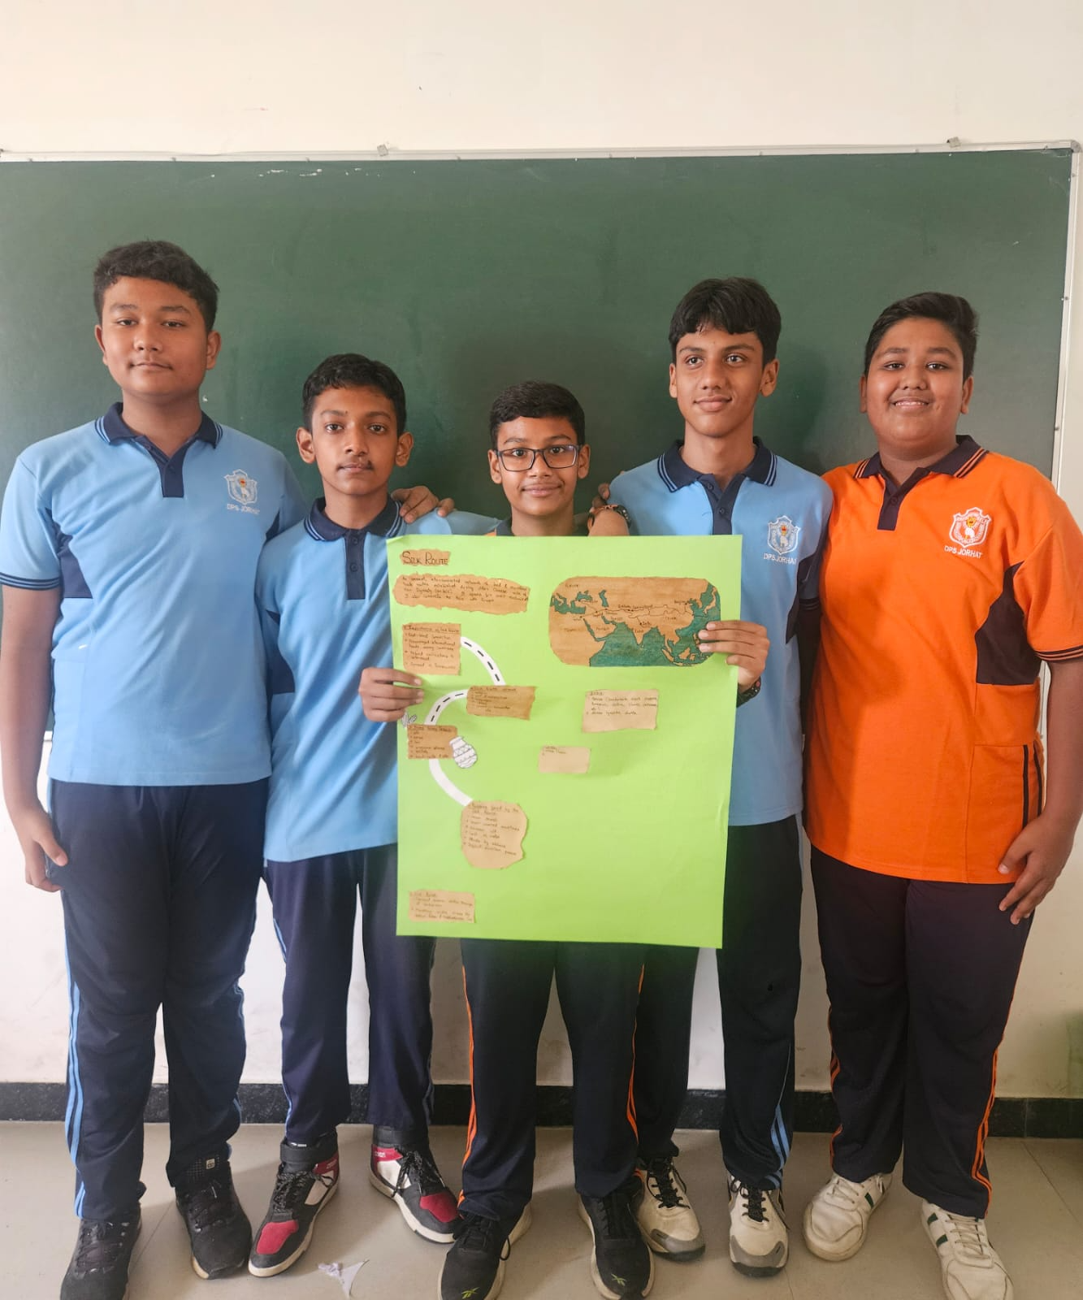
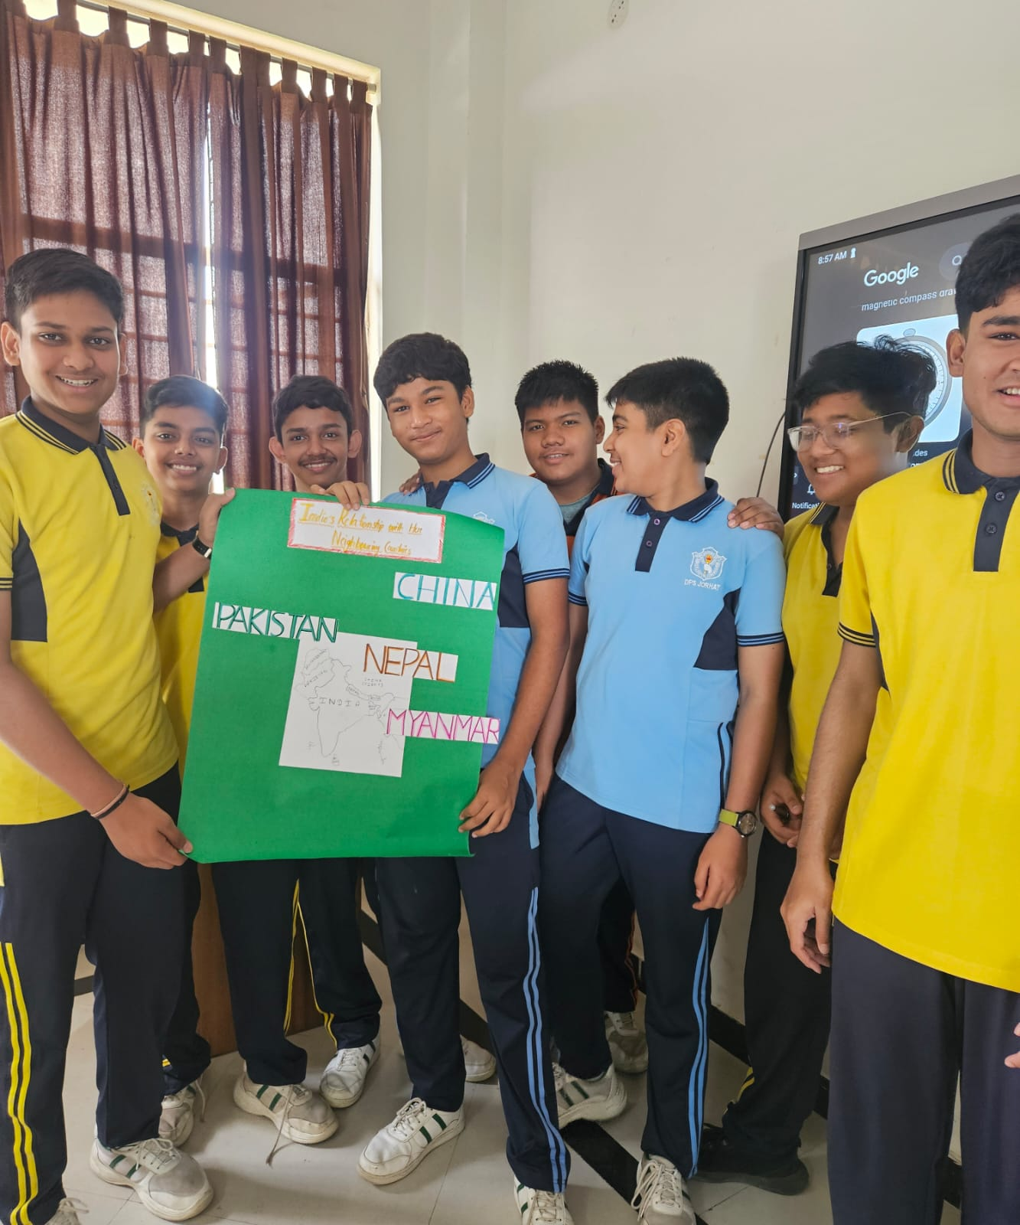
PICTURES
INSERT ANY PICTURES OR VIDEOS BY COPYING THIS SLIDE

Slide 18
TOURS &FIELD VISITS DONE
04

Slide 19
TOURS &FIELD VISIT DONE
GRADE: IX& X
Historical Places of sivsagar
AUGUST 2026
GRADE:XI & XII
Kaziranga National Orchid &biodiversity park
AUGUST 2026

Slide 20
ASSESSMENTS TAKEN &EXAM PERFORMANCE
05

Slide 21
ASSESSMENT TAKEN
CLASS | ASSESSMENT TYPE | DATE
IX A | MONDAY TEST | 18.05.2026
IX B | MONDAY TEST | 18.05.2026
X A | MONDAY TEST | 18.05.2026
X B | MONDAY TEST | 18.05.2026

Slide 22
ASSESSMENT TAKEN
CLASS | ASSESSMENT TYPE | DATE
XII(HUM) | MONDAY TEST | 25.05.2026
XII (HUM) | MCQ | 18.05.2026
XII (HUM) | MCQ | 05.5.2026
XII (HUM) | MCQ | 22.05.2026

Slide 23
COPY CORRECTION &MAINTENCE
06

Slide 24
COPY CORRECTION &MAINTENENCE
CLASS | REMARKS
IX A | Maintain on a regular basis.
IX B | Maintain on a regular basis
X A | Maintain on a regular basis
X B | Maintain on a regular basis
XI (HUM) | Maintain on a regular basis
XII (HUM) | Maintain on a regular basis

Slide 25
BEHAVIOURIAL OBSERVATION OF STUDENTS
07

Slide 26
OBSERVATION OF STUDENTS
A detailed report consisting of students behavioural observations and subject teachers observation is sent to each student after every Cycle Assessment.

Slide 27
Co –scholastic Activities done
08

Slide 28
ATLAS GAME (XII(HUM)
CATEGORY:CO-scholastic Activity (Geography Enrichment Activity)
OBJECTIVES: To enhance students 'map skills ,location identification and geographical knowledge through an interactive and engaging learning experience.

Slide 29
Measures taken when students miss classes Communication / Interaction provided to parents
09

Slide 30
Measures taken when students miss classes
SHARE CLASS NOTES AND LEARNING MATERIALS
Provide notes and worksheets and study materials through class groups.
Share important announcements and assignments promptly.
2.CONDUCT FOLLOW-UP SESSIONS
Arrange remedial or catch –up session for students who have missed important concepts.
Encourage peer support and collaborative learning.
3. MONITOR ACADEMIC PROGRESS
Track completion of missed assignments and classwork.
Provide additional guidance where required.
4. COUNSELLING AND SUPPORT
Identify reasons for frequent absenteeism and offer appropriate support.
Coordinate with parents ,counsellors if needed.

Slide 31
THANK YOU

