Slide 1
DELHI PUBLIC SCHOOL JORHAT
Kaizen Meeting
GRADE IX- XII

Slide 2
TOPICS
01
SYLLABUS COMPLETION
04
TOURS & FIELD VISITS DONE
02
LESSON PLANNING
05
ASSESSMENTS TAKEN & EXAM PERFORMANCE
03
BEST PRACTICES IN YOUR SUBJECTS
06
COPY CORRECTION & MAINTENENCE

Slide 3
TOPICS
07
BEHAVIOURAL OBSERVATION OF STUDENTS
08
CO SCHOLASTIC ACTIVITIES DONE IN YOUR SUBJECT
09
MEASURES TAKEN WHEN STUDENTS MISS CLASSES AND COMMUNICATION/INSTRUCTIONS PROVIDED TO PARENTS

Slide 4
Syllabus Completition
01

Slide 5
GRADE IX
GRADE X
CH -1 The story of village Palampur (DONE)
Ch-2 People As resources (Half Done)
CH-1 Development (DONE)
Ch-2 Sectors of Indian Economy (July)

Slide 6
GRADE XI
GRADE XII
Micro Economics
Indian Economic Development
UNIT -4 Introduction (DONE)
UNIT -5 Consumer's Equilibrium and Demand (Done)
STATISTICS
UNIT-1 Introduction (DONE)
UNIT-2 Collection, Organisation and Presentation of data (JULY)
Unit 6: Development Experience (1947-90) and Economic Reforms since 1991 (DONE)
Unit 7: Current challenges facing Indian Economy (JULY)

Slide 7
Lesson Planning
02

Slide 8
ALL LESSON PLAN ARE UPDATED IN THE DRIVE.
Links -
https://drive.google.com/drive/folders/1SRoWXYq0Ou5phLymwCrjFr24bHROoJT2?usp=drive_link
https://drive.google.com/drive/folders/146nNRVCB7AXs1HYqlmj5KBuTBhG04lKB?usp=drive_link
https://drive.google.com/drive/folders/1imSnMLOFjsikeXq8DXXihc51eIq6BoOs?usp=drive_link

Slide 9
Best Practices.
03

Slide 10
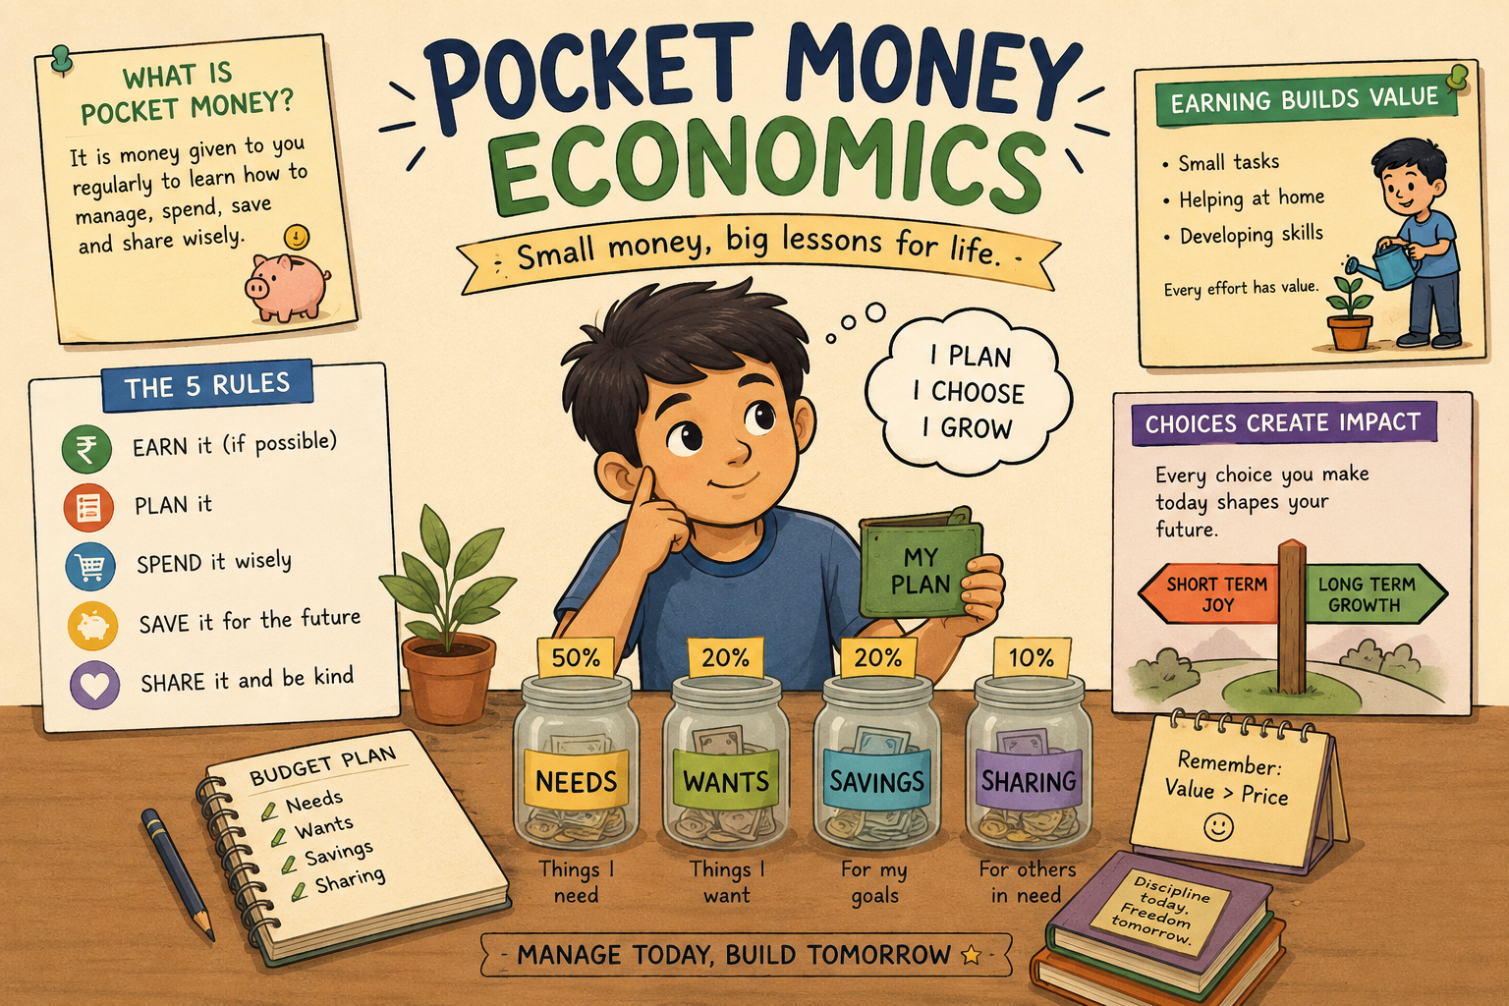
Pocket money economics XI
Students maintain a one week record of their spending.
They analyze need vs. wants, saving habits, and opportunity costs.

Slide 11

Be the Finance Minister’ Challenge XII –
Present students with a real economic
Problem( unemployment, poverty, inflation,
Environmental degradation). In groups, they
design policies and present a mini-budget
to the class.

Slide 12
Assessment taken and Exam performances.
04

Slide 13
Assessment Taken- Cycle Test , MCQ test, Presentation on selected topics, Assessment through NCERT activities.
Exam Performances –
GRADE XII –
BGL – 05 05 - Absent During exam
GL- 13
AGL- 15
GRADE XI-
AGL- 8
GL- 1
BGL- 0

Slide 14
Copy Correction
04

Slide 15
All copies are corrected are sealed from principal office.

Slide 16
Measures taken when students miss classes and communication provided to parents
04

Slide 17
Anecdotal Report.
Sent email if the case is severe.
Contact with the parents through call.

Slide 18
THANKS!

